Slide 1
Dr Subhash Technical Campus
Group :- 1 to 8 (Mech. 1)
Topic :- Hydal Power
Guided By :-Prof. Ankit Sata

Slide 2
Student Names
1) Ameepara Jignesh
2) Barad Bhavdipsinh
3) Baraiya Yash

Slide 3
Hydroelectric Power
Energy created by flowing water

Slide 4
Who’s using it?
Supplies 20% of world’s electricity and 6% of it’s total commercial energy
3 largest producers are Canada, U.S., and Brazil
Projected use over the next 10 years: Canada 70%, China 10%, U.S.10%

Slide 5
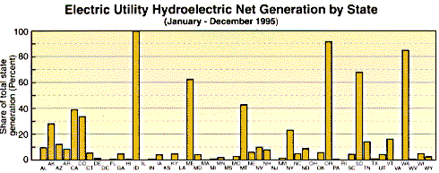

Slide 6
What is it?
Large Scale
-dam is built across a river to create reservoir
-stored water is then allowed to flow through pipes at controlled rates
-water goes through turbines and produces electricity
Small Scale
-low dam is built
-no reservoir
-output varies with seasonal changes in stream flow
-less damaging than large scale projects

Slide 8
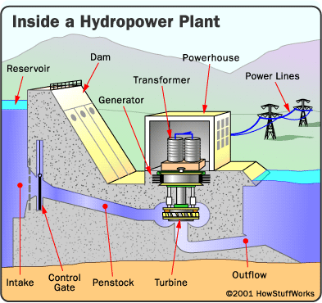

Slide 9
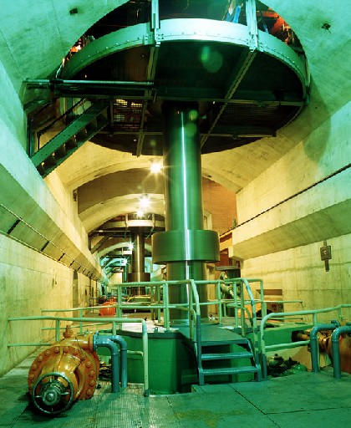

Slide 10
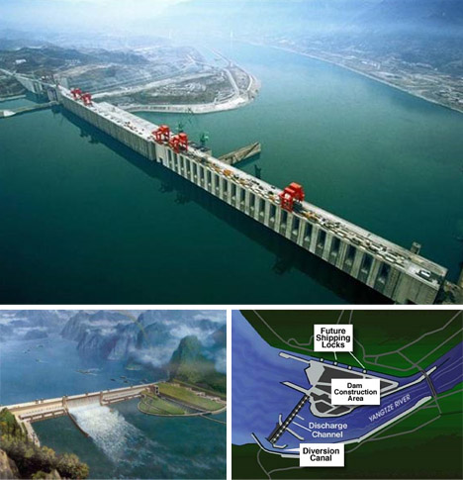
The largest Hydroelectric Power Plant in the world
The Yangst River in China

Slide 11
How useful is it?
Moderate to high net useful energy yield
fairly low operating and maintenance costs
low pollution
rarely shut down
help control flooding
supply a regulated flow of irrigation water to lowlands below the dam

Slide 12
Compared to Others
Has moderate to high net useful energy
Solar energy and hydroelectric are the highest producers of energy besides nonrenewable resources

Slide 13
Drawbacks
Flood vast areas
destroys wildlife habitats
uproots people
keeps nutrients from being sent downstream
decreases fish harvests below the dam
keep fish from migrating upstream
kills large numbers of fish

Slide 14
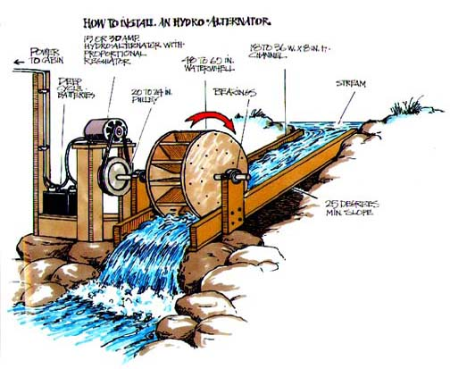

Slide 15
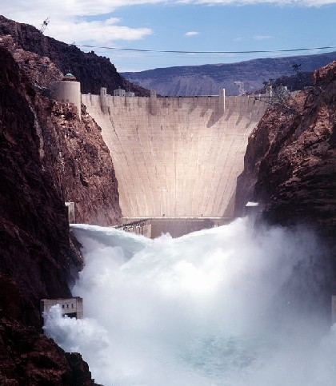
Hoover Dam

Slide 16
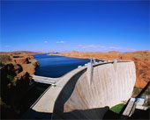
Glen Canyon Dam (Utah)

